Slide 1
Section 7.2 Scaled Diagrams and Reductions
© Copyright all rights reserved to Homework depot: www.BCMath.ca

Slide 2
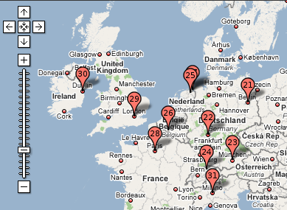
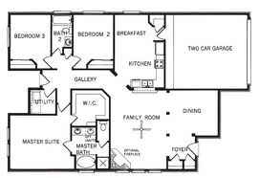
Reductions
A reduction will reduce the size of an object to a smaller diagram
Reductions occur in maps, floor plans, and miniatures
Reductions occur when the scaled factor is between 0 and 1
ie: A scaled factor of means that the scaled diagram is 10 times smaller than the actual image → “REDUCTION”
Ie: a scaled factor of “10” means that the scaled diagram is 10 times larger than the actual image → “ENLARGEMENT”
© Copyright all rights reserved to Homework depot: www.BCMath.ca

Slide 3
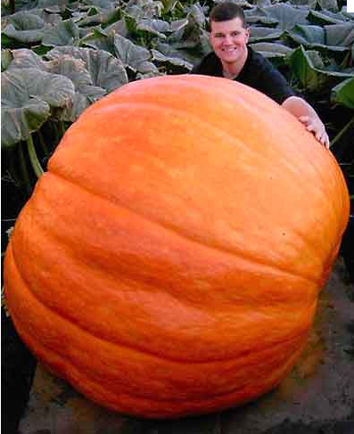
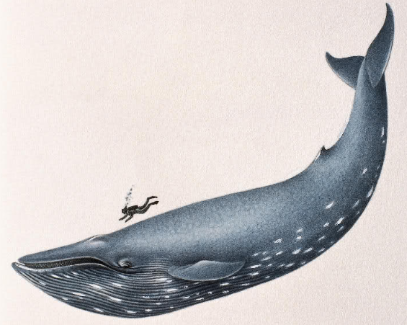
Ex: Given each scaled factor, determine the length of the scaled diagram:
Actual Object:
Scaled Factor
Scaled Diagram:
© Copyright all rights reserved to Homework depot: www.BCMath.ca

Slide 4
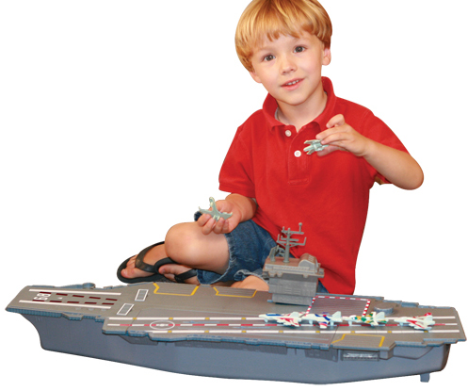
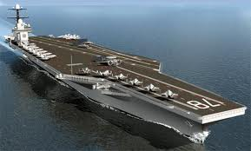
Finding Scale Factors
Divide the length of the scaled object by the length of the actual object
When calculating the scaled factor, make sure both objects have the same units, ie: cm, m, mm
If they are not, convert them into the same units first
NOTE: The scaled factor itself does not have any units
© Copyright all rights reserved to Homework depot: www.BCMath.ca

Slide 5
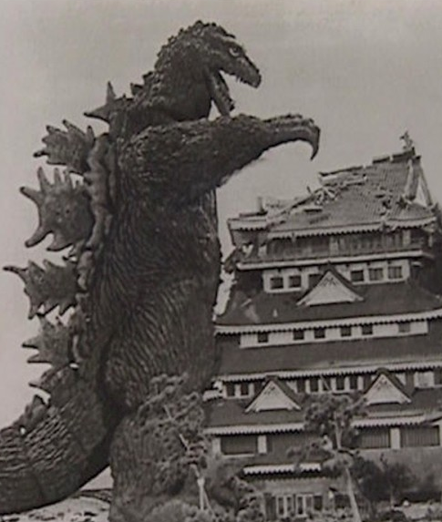
Ex: Find the scaled factor for the following:
© Copyright all rights reserved to Homework depot: www.BCMath.ca

Slide 6
Ex: If the radius of the earth is 6378km and the radius of Jupiter is 71492km, what is the scaled factor and the size of the earth model if the radius of the jupiter model is 30cm?
© Copyright all rights reserved to Homework depot: www.BCMath.ca

Slide 7
Miniature World
© Copyright all rights reserved to Homework depot: www.BCMath.ca

Slide 8
Homework:
P329 #4-8, 11 - 15
© Copyright all rights reserved to Homework depot: www.BCMath.ca

